Slide 1

Predictive modelLING

Slide 2

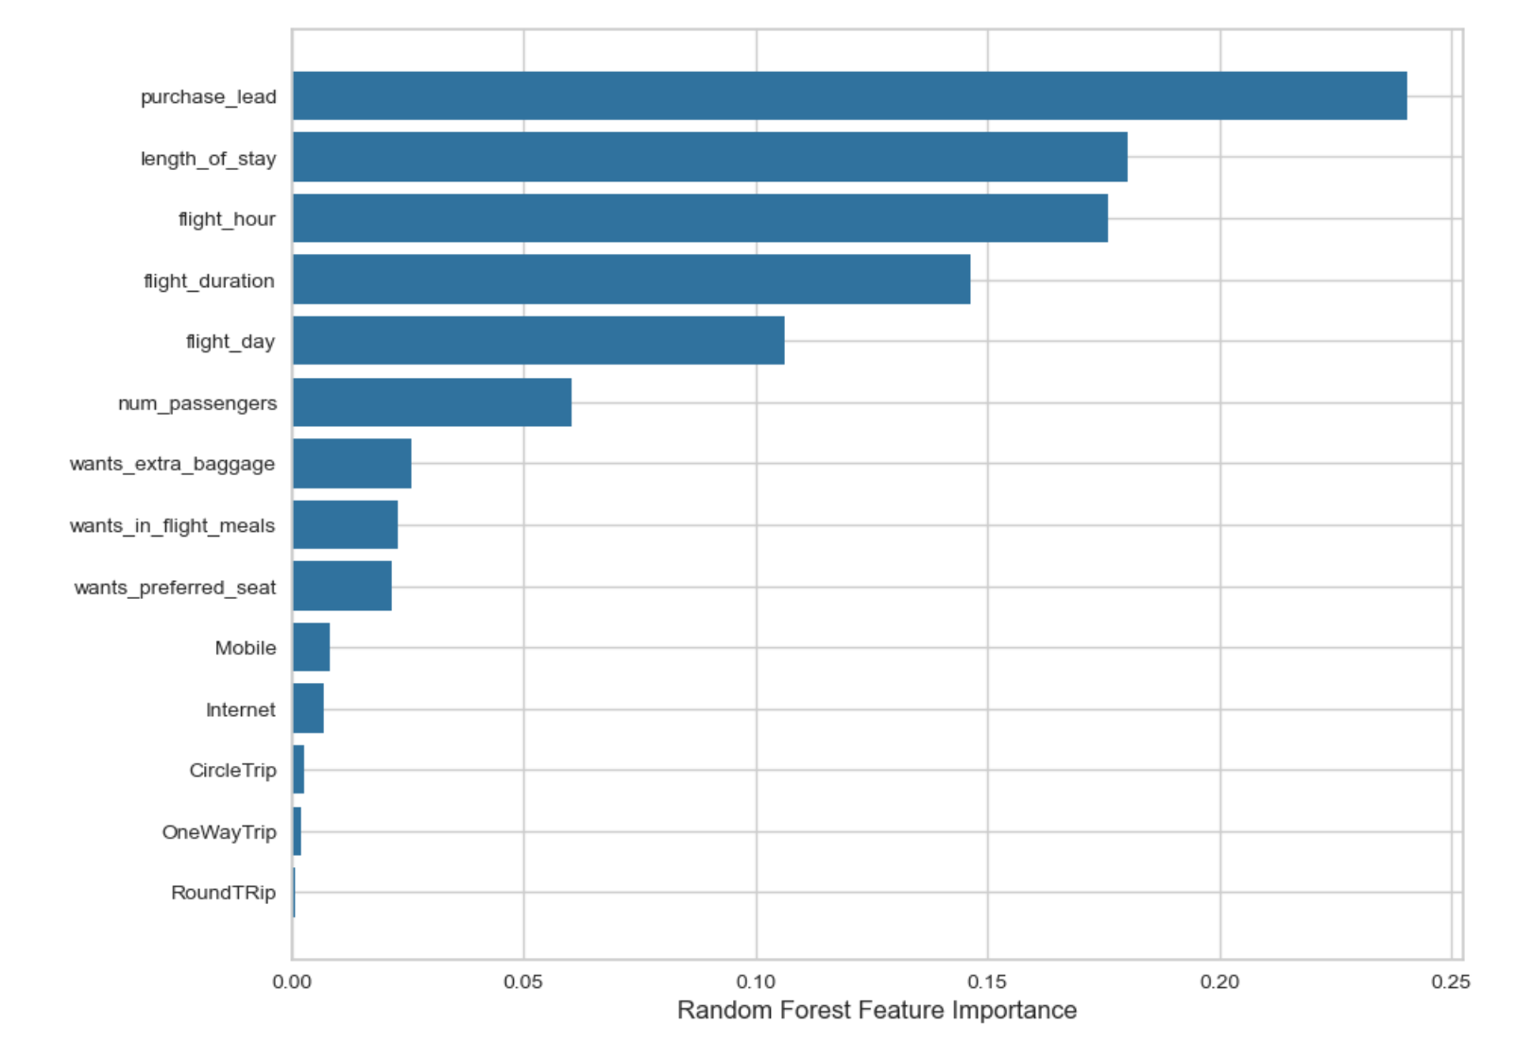
KEY METRICS
Recall Rate
58%
Precision of Bookings
61%
Accuracy of Bookings
61%
A chance prediction of true complete bookings
A prediction of actual bookings will be successfully completed
Accuracy of the model predicting successful or incomplete booking
Accuracy of the model predicting successful or incomplete booking
Balancing the Dataset for Improved Predictions
- Our top priority: Accurately predicting successful bookings.
- Imbalanced datasets may yield high accuracy, but less precise success predictions.
- Solution: Dataset balancing - 8,000 incomplete bookings, 7,000 complete bookings.
There is a 66% chance prediction of true Incomplete bookings
Most important features for driving a successful flight booking

